Slide 1
Price Regulation in the Supply-Demand Framework
Fall 2023
Notes:
1

Slide 2
Price Regulation: Examples
Rent control (ceiling)
Minimum wage (floor)
College athletes work without cash comp (ceiling)
Biblical prohibitions of usury (ceiling)
Organ donation (ceiling)
Salary caps for bank executives (ceiling)
Federal limits on payments to physicians (ceiling)
Farm price supports (floor)
Military pay (ceiling)
Food prices (ceiling)

Slide 3
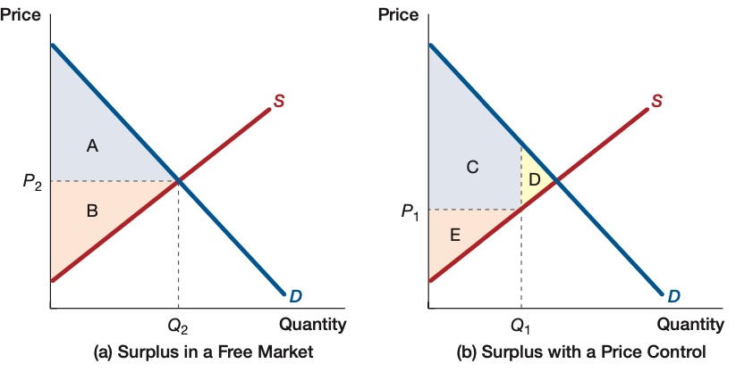
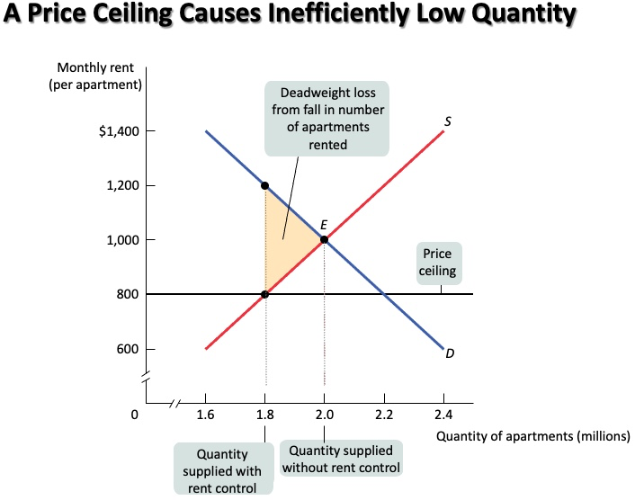
Acemoglu, Laibson, List
Miraculous?
Good received by high-value buyers
Regulation does not affect supply or demand curve
Both floors and ceilings reduce quantity
Demand is irrelevant for determining quantity
Merely effects “shortage”
Krugman & Wells

Slide 4
With elastic supply, a price ceiling eliminates ALL trade. Really?! Will traders surrender that easily?
Price
Aggregate loss
Price ceiling
S
Krugman & Wells
600
D
0
1.6
1.8
2.0
2.2
2.4
Quantity

Slide 5
Price-regulation Principles
Competition delivers unintended consequences
Intended beneficiaries compete with each other
Pre-regulation competition
Non-price product attributes

Slide 6

12/24/14: A security van in Hong Kong spilled bundles of banknotes … paralyzing traffic and igniting a scramble by passers-by to collect the money.

Slide 7
Price-regulation Principles
Competition delivers unintended consequences
Intended beneficiaries compete with each other
Pre-regulation competition
Non-price product attributes
Buyers and sellers will look for other ways to trade
Potential for enriching regulators
False litmus tests
Queues
Reduced quantity traded
Today: recognize these principles in the supply-demand framework

Slide 8
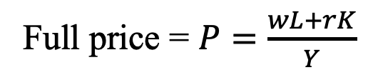

Figure 2. Industry Supply without Price Regulation
Each producer’s marginal cost is its average cost.
Full price = $P=\frac{wL+rK}{Y}$
Unregulated marginal cost
$$Y=F\left(K,L\right)$$
Quantity Y
0

Slide 9
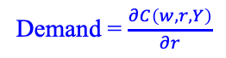
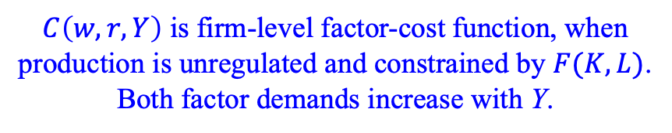
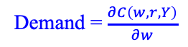
Two Simultaneous Factor Markets
Each quantity depends on both factor prices
Figure 3a
Figure 3b
r
w
K supply
L supply
Demand = $\frac{∂C\left(w,r,Y\right)}{∂w}$
Demand = $\frac{∂C\left(w,r,Y\right)}{∂r}$
Quantity of K
Quantity of L
$C\left(w,r,Y\right)$ is firm-level factor-cost function, when production is unregulated and constrained by $F(K,L)$.
Both factor demands increase with Y.

Slide 10
Consumers as part of the production process
Let L denote consumer input
A.k.a., “downstream inputs”
Time, effort, travel, resources
K denotes upstream inputs. “Quality”?
Becker 1965 “A Theory of the Allocation of Time”
Same supply-demand model, just interpretation
Full price is (rK+wL)/Y.
Consumer price is 𝛒 = rK/Y
e.g., consumer purchasing one unit is quoted P but given credit for the value wL of L provided.
Upstream firms receive net rK as they pass downstream

Slide 11

Who should wait? Employees or customers?

Slide 12


Upstream vs downstream inputs: More examples
L denotes effort traveling to farm or manufacturer
geographically
through time (e.g., weekends/holidays)
K = vacancies that enhance consumer experience
L vs K: consumer vs. firm supply of credit

Slide 13
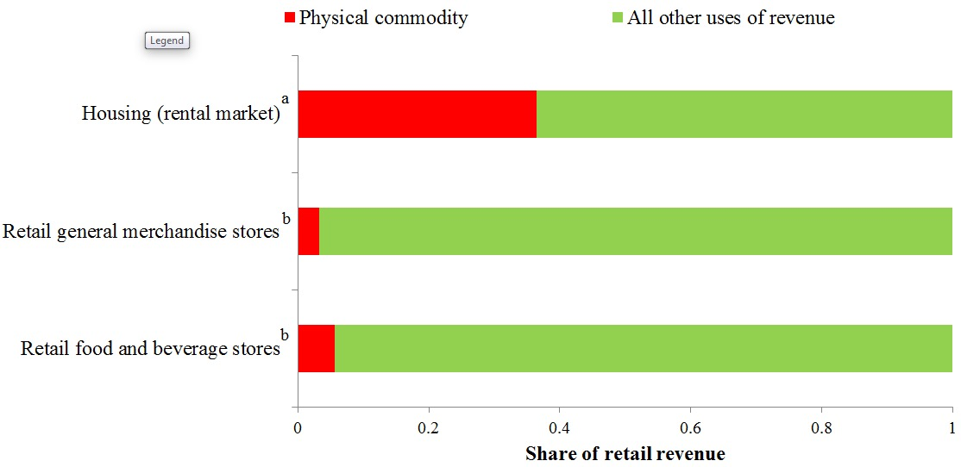
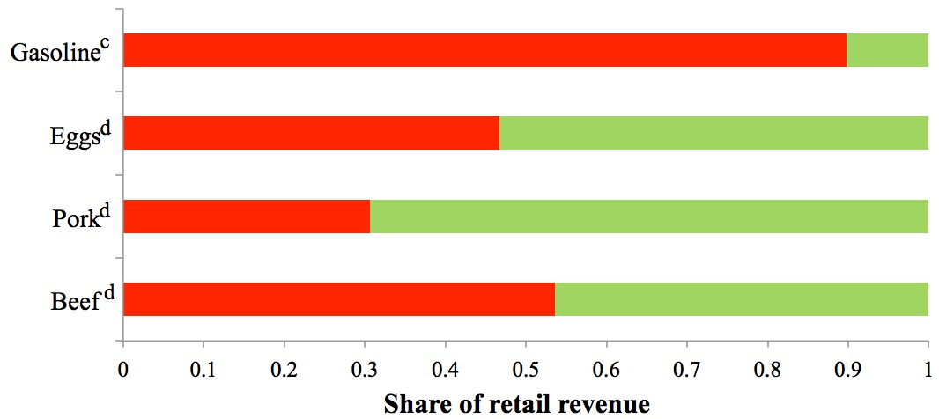
Figure 4. Cost structures for selected industries and retail commodities, 2007
Industries
Retail
commodities
Notes are on the following page.

Slide 14
Figure 2 notes.
ª"Physical commodity" refers to the net operating surplus from the housing sector, 2006. It includes revenues used for mortgage payments, but excludes depreciation.
^{b}"Physical commodity" refers to output from any agricultural, forestry, fishing, or manufacturing industry.
^{c}"Physical commodity" includes taxes.
^{d}"Physical commodity" refers to revenue paid to farmers.
Sources
Mayerhauser and Reinsdorf (2007),
Use Tables from the Bureau of Economic Analysis input-output accounts,
USDA Economic Research Service's Meat Price Spreads,
USDA agricultural prices (eggs),
BLS Average Prices (eggs), and
US Energy Information Administration.

Slide 15
The Unregulated Market Minimizes Cost
Not marginal cost
Figure 3a
Figure 3b
r
w
K supply
L supply
Demand = $\frac{∂C\left(w,r,Y\right)}{∂w}$
Demand = $\frac{∂C\left(w,r,Y\right)}{∂r}$
Quantity of K
Quantity of L
Aggregate factor cost is the sum of the two areas

Slide 16
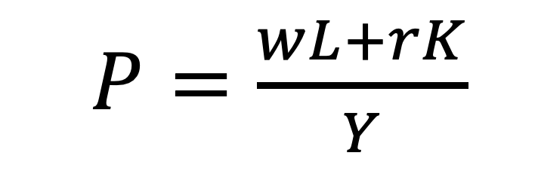
What happens to marginal cost?
From a regulation that constrains rK/Y
Near efficient factor mix
K and L tradeoff along isoquant at rate w/r
Therefore no effect on P holding w and r constant
BUT w will increase while r decreases
The factor with less elastic supply will dominate because its price changes more
i.e., a ceiling increases or decreases P according to whether K is more or less elastically supplied, respectively.
Whatever is a ceiling’s effect on P, a floor has the opposite
i.e., MC curve is rotated
Hold output (Y) fixed.
i.e., how does the MC curve shift?
Ceiling
Floor
$P=\frac{wL+rK}{Y}$

Slide 17
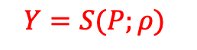
Figure 5a. Industry Supply with and without Price Regulation
Regulation restricts the amount paid per unit quantity to producers, who own the more elastically supplied factor (K).
Full price = $P=\frac{wL+rK}{Y}$
$$Y=S(P;ρ)$$
MC with ceiling
Unregulated marginal cost
E
MC with floor
G
Unregulated marginal cost
Quantity Y
0
K (owned by producer) is more elastically supplied than L (owned by consumer). As drawn, both floor and ceiling refer to the same value of rK/Y. At the point E, neither binds. Above E, r is great enough that a ceiling would bind but a floor would not. Below E, vice versa.

Slide 18
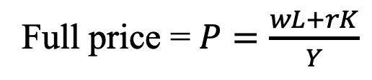
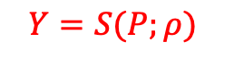
Figure 5b. Industry Supply with and without Price Regulation
Regulation restricts the amount paid per unit quantity to producers, who own the less elastically supplied factor (K).
Full price = $P=\frac{wL+rK}{Y}$
Unregulated marginal cost
$$Y=S(P;ρ)$$
MC with ceiling
E
MC with floor
Demand
Unregulated marginal cost
Quantity Y
0
K (owned by producer) is less elastically supplied than L (owned by consumer). As drawn, both floor and ceiling refer to the same value of rK/Y. At the point E, neither binds. Above E, r is great enough that a ceiling would bind but a floor would not. Below E, vice versa.

Slide 19
Physician Price Caps
Maximum on what can be charged for office visits
K = physician inputs, especial time
In the short run, inelastic (say, fixed) supply (Fig. 5b)
In the long run, elastic supply (Fig. 5a)
L = patient inputs, such as travel time, waiting time
Fig 5b
more office visits in the short run
Less K. E.g., consolidate office locations (patients travel more, physicians less)
Fewer vacancies in office schedule: physicians wait less. Patients wait more, exert scheduling effort

Slide 20
Inverse K

Slide 21
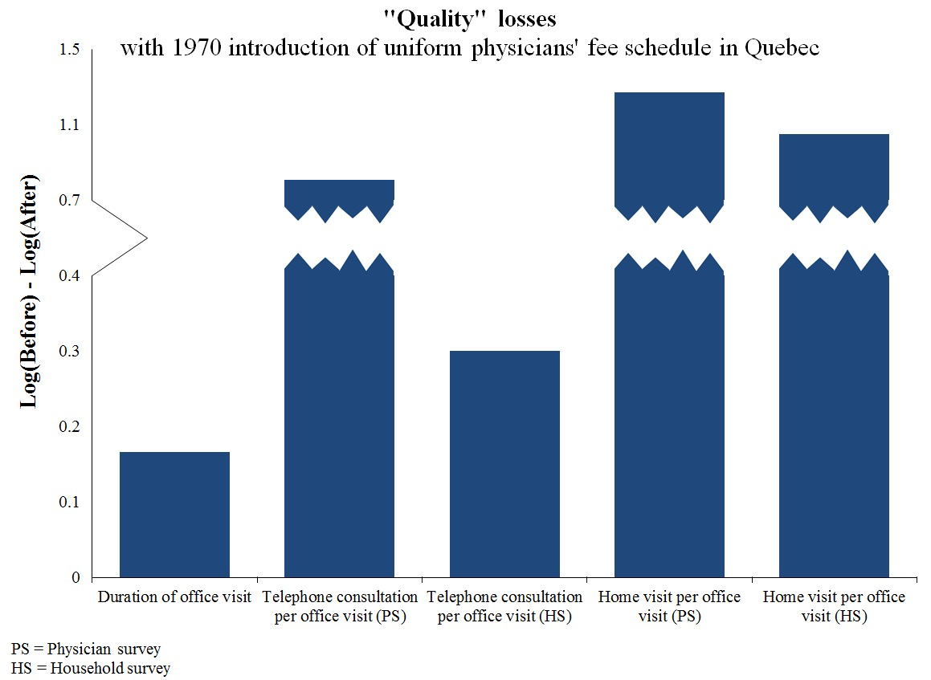
K losses with 1970 introduction of uniform physicians’ fee schedule in Quebec

Slide 22
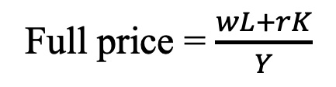
Figure 5c. Industry Supply with and without Price Regulation.
Regulation restricts the amount rK/Y paid per unit quantity by consumers to producers
Full price = $\frac{wL+rK}{Y}$
MC with ceiling
Unregulated marginal cost
E
MC with floor
Unregulated marginal cost
Quantity Y
0
Both factors are equally elastically supplied. As drawn, both floor and ceiling refer to the same value of rK/Y. At the point E, neither binds. Above E, r is high enough that a ceiling would bind but a floor would not. Below A, a floor would bind but a ceiling would not.

Slide 23

Price-regulated Equilibrium
Y, L, K, P, w, r
P is firm-level marginal cost = (rK+wL)/Y
Feasible: Y = F(K,L)
Regulatory compliance: $rK/Y=ρ$
On the demand curve: Y = D(P)
On the (inverse) factor-supply curves r = R(K) , w = W(L)
Regulated factor mix $R\left(K\right)K/F(K,L)=ρ$
For reference: efficient factor mix
$$\frac{R(K)}{W(L)}=\frac{∂F/∂K}{∂F/∂L}$$

Slide 24
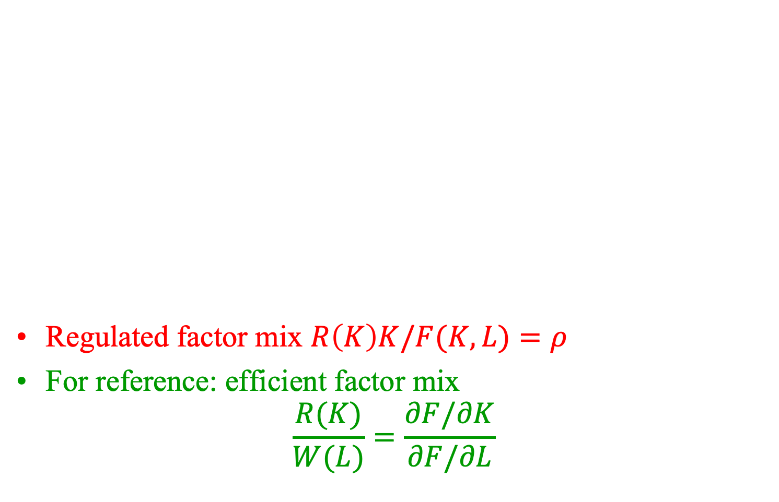
Price-regulated Equilibrium
Y, L, K, P, w, r
P is firm-level marginal cost = (rK+wL)/Y
Feasible: Y = F(K,L)
Regulatory compliance: $rK/Y=ρ$
On the demand curve: Y = D(P)
On the (inverse) factor-supply curves r = R(K) , w = W(L)
Regulated factor mix $R\left(K\right)K/F(K,L)=ρ$
For reference: efficient factor mix
$$\frac{R(K)}{W(L)}=\frac{∂F/∂K}{∂F/∂L}$$

Slide 25
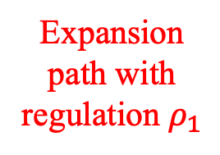
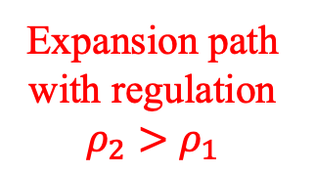
Figure 6. Factor distortions from price regulation
Consumer input, L
Unregulated factor mix
Expansion path with regulation $ρ_{1}$
Tighter floors or weaker ceilings cross at greater output
Both figs 5a and 5b
Expansion path with regulation $ρ_{2}>ρ_{1}$
0
Seller input, K

Slide 26


Slide 27
Figure 4. Cost structures for selected industries and retail commodities, 2007
Industries
Retail
commodities
Notes are on the following page.

Slide 28
Rent control
Maximum charge on leased housing
K = landlord inputs
In the short run, inelastic (say, fixed) supply (Fig. 5b)
In the long run, elastic supply (Fig. 5a)
L = tenant inputs, such as financing or maintenance
Fig 5b
more leases in the short run
Less K. E.g., landlord stops maintaining
Fig 5a
Fewer leases in the long run.
But not zero!

Slide 29
Figure 5ab. Industry Supply with and without Price Regulation
Regulation restricts the amount paid per unit quantity to producers, whose factor (K) is supplied inelastically in the short run but elastically in the long run.
Full price = $P=\frac{wL+rK}{Y}$
$$Y=S(P;ρ)$$
Unregulated marginal cost
MC with ceiling - LR
$$Y=S(P;ρ)$$
MC with ceiling - SR
E
MC with floor
G
Demand
Unregulated marginal cost
Quantity Y
0
As drawn, both floor and ceiling refer to the same value of rK/Y. At the point E, neither binds. Above E, r is great enough that a ceiling would bind but a floor would not. Below E, vice versa.

Slide 30
With elastic supply, rent control eliminates ALL trade. Really?! Will traders surrender that easily?
Monthly rent (per apartment)
Aggregate loss
Price ceiling
S
Krugman & Wells
600
D
0
1.6
1.8
2.0
2.2
2.4
Quantity of apartments (millions)

Slide 31


Slide 32

Market Shares of Colorectal Cancer Regimens in the U.S. and Europe

Slide 33
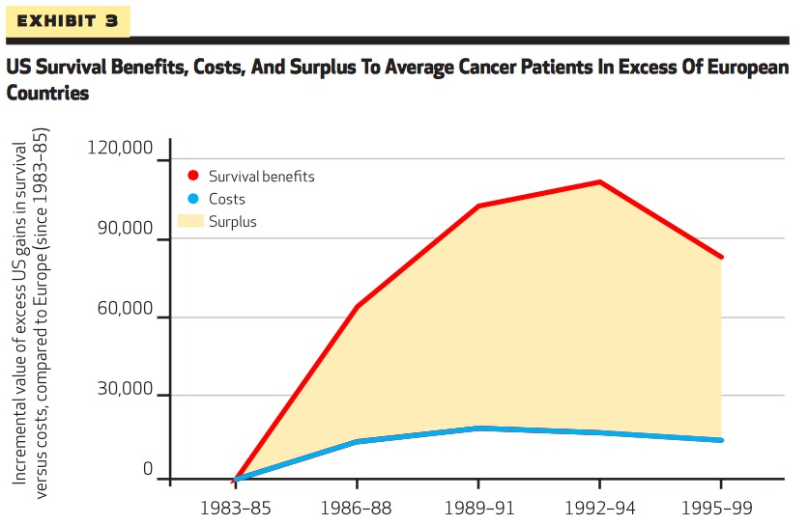
Source: Philipson, et al., Health Affairs 2012.

Slide 34
Price Controls: Conclusions
Expect competition rather than miracles. E.g., “quality” competition
Price regulations rotate the supply curve
The full price can increase or decrease
The quantity can decrease or increase
Long-run effect can be in the opposite direction as the short-run effect

